Slide 1
Capstone Project on “Predicting Profitability by Analyzing Buying Behavior of Customers for Superstore Chain”
Presented by:
Group no.: 5 Batch: 2019 Location: Pune
Group Members :
Jayshree Sahu
Pragya Apurva
Priyanka Koparkar
Swati Mishra
Research Supervisor:
Deep Sachdev

Slide 2
Introduction To The Dataset

Slide 3
1. Original Features-Divided Into Four Types
Demographics Features
Age
TakenFreeDelivery
Behavioral Features
Monetary Features
HighestSaving
Promotional Features
Gender
Tenure
CityTier
FootfallInDiscountPeriod
TakenProdFromPromo
LastMonthCouponUsed
SavingPercent
AvgSaving
AvgNumberOfProduct
AvgBillAmount
MembershipCard
SatisfactionScore
Complain
VisitInLastMonth
PreferredPaymentMode

Slide 4
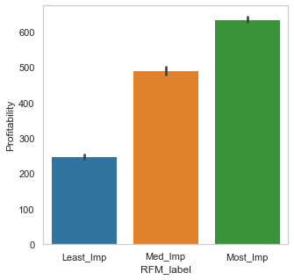
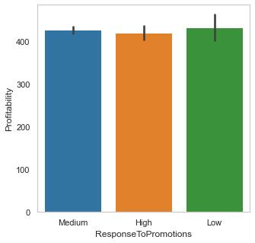
2. New Features-Derived From Original Features
AvgNumberOfProduct
VisitInLastMonth
RFM_Label
AvgBillAmount
TakenFreeDelivery
FootfallInDiscountPeriod
ResponseToPromotion
TakenProdFromPromo

Slide 5
3. New Features-Created By Transformation
8 of the original features were treated by:
Scaling
Binning
Log Transformation
14 new features after transformation

Slide 6
Final Features After Data Cleaning
3 categorical variables one hot encoded into 7 new columns
38
Independent features after Data Cleaning
2
Derived Features
14
Features Transformed
18
Original Features

Slide 7
Feature Selection

Slide 8
Feature Selection Techniques
Multicollinearity
Identifying Important Features
Select K Best
Extra Tree Regression
VIF
Lasso

Slide 9
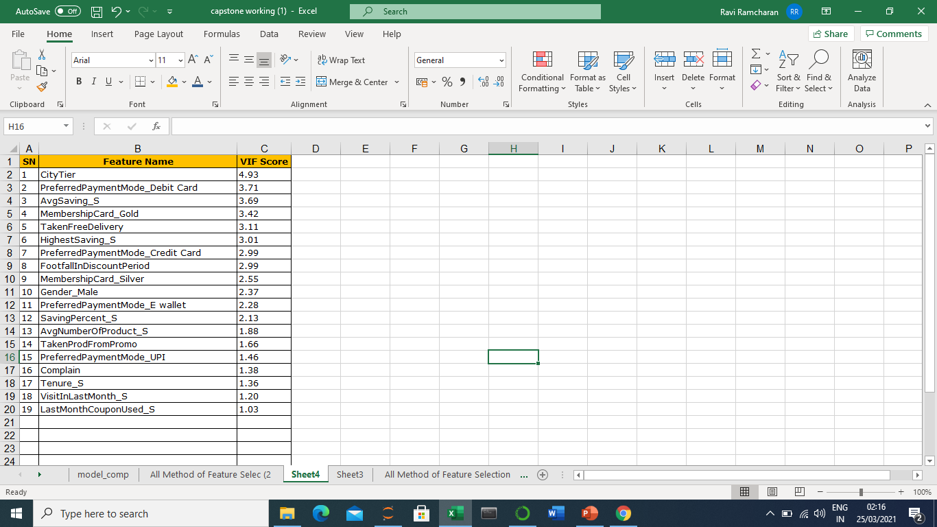
VIF – Cut-off value >5
Set 1 Features
From 38 , reduced to a list of 19 features

Slide 10
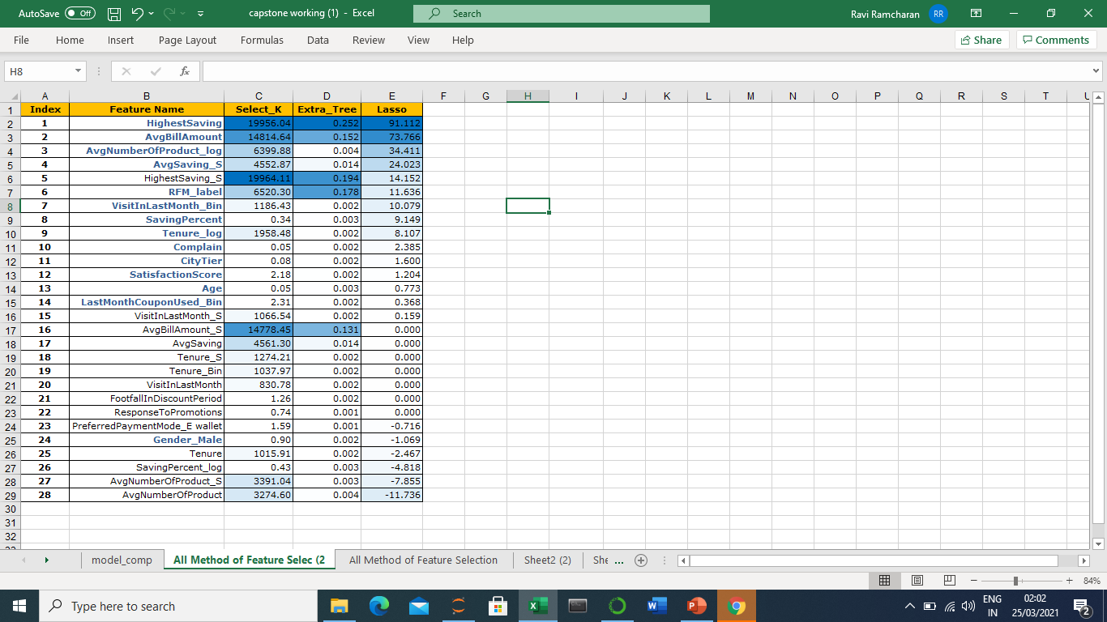
Feature Selection Using
SelectKBest, ExtraTree & Lasso
Set 2 Features
HighestSaving
AvgBillAmount'
AvgNumberOfProduct_log
AvgSaving_S
RFM_label
VisitInLastMonth_Bin
SavingPercent
Tenure_log
Complain
CityTier
SatisfactionScore
Age
LastMonthCouponUsed_Bin
Gender_Male

Slide 11
Final Reduced Features
Feature Set 1
19 features
38 features
VIF
(Cut-off > 5)
Feature Set 2
14 features
38 features
Select K Best
Extra Tree Reg
Lasso

Slide 12
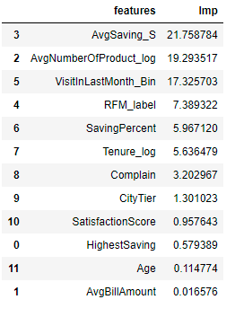

Feature Elimination
During model training and iterations, feature elimination by sign of the coefficient
Dropped ‘Complain’ feature in the next iteration as it showed a positive relation with Profitability which ideally should be reversed case.
Complain is showing positive impact on Profitability
Select K Best
Extra Tree Reg
Lasso

Slide 13
Model Selection & Evaluation

Slide 14
Model Comparison
Linear Regression
Random Forest Regression
Lasso Regression

Slide 15
Model Comparison-First Model
Linear Regression
Random Forest Regression
Lasso Regression
Basic Model With Good Explainability

Slide 16
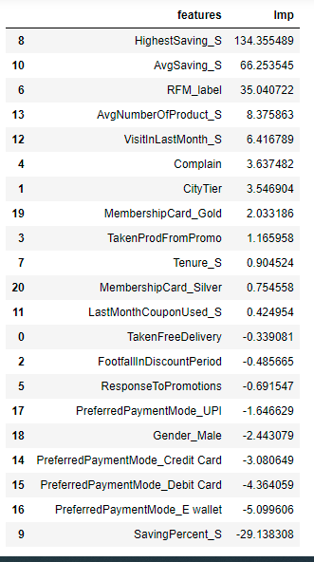
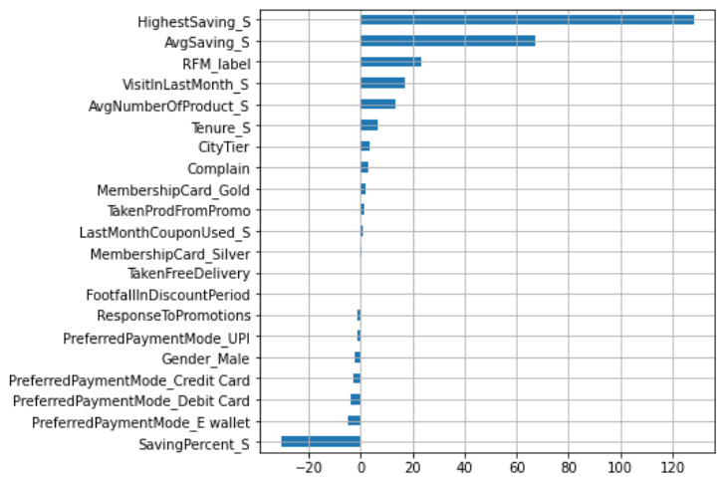
Linear Regression Results
Metrics
Metrics | Train | Test
R-SQ | 0.88 | 0.87
AD-RSQ | 0.88 | 0.86
RMSE | 80.97 | 82.61
MSE | 6555.97 | 6824.92
MAE | 62.09 | 44.89
Metrics
Features Importance
Features Importance

Slide 17
Model Comparison-Second Model
Linear Regression
Random Forest Regression
Lasso Regression
Non linearity of data
Based on Average of Multiple trees

Slide 18
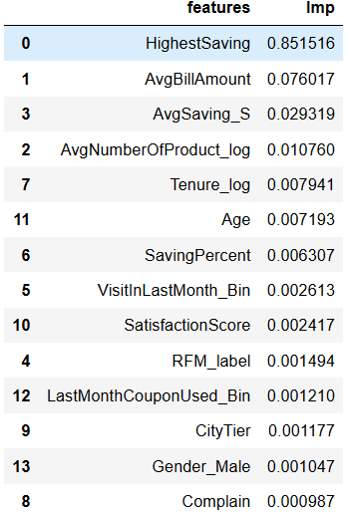
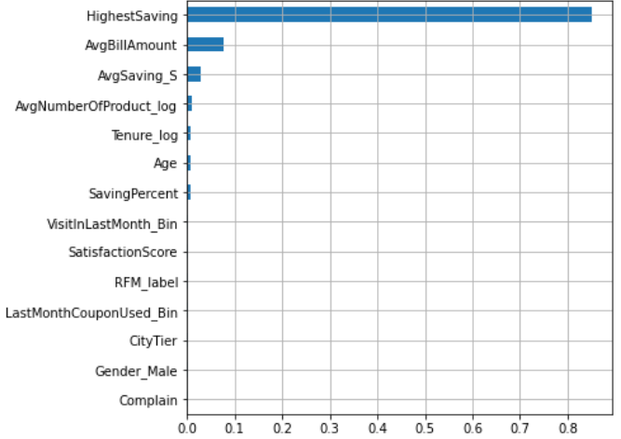
Random Forest Regression
Metrics
Metrics | Train | Test
RSQ | 0.99 | 0.93
AD-RSQ | 0.99 | 0.93
RMSE | 21.96 | 59.83
MSE | 482.09 | 3579.90
MAE | 14.67 | 44.89
Features Importance

Slide 19
Model Comparison–Third Model
Linear Regression
Random Forest Regression
Lasso Regression
Penalizes Collinear variable
Previous Model was overfitting

Slide 20
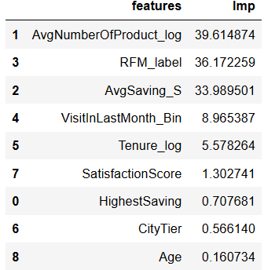
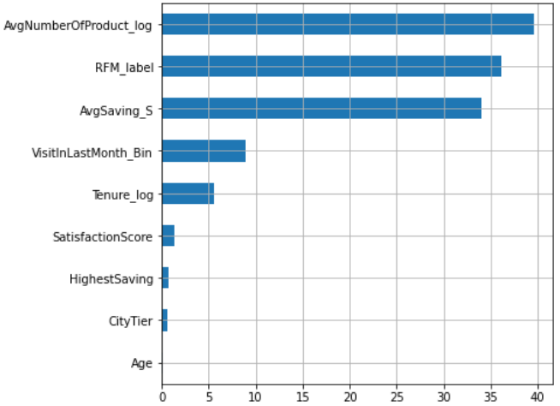
Lasso Regression Results
Metrics
Metrics | Train | Test
RSQ | 0.88 | 0.87
AD-RSQ | 0.88 | 0.87
RMSE | 80.68 | 82.66
MSE | 6509.64 | 6832.57
MAE | 61.13 | 61.99
Features Importance

Slide 21
Recommendations and Conclusions

Slide 22
Recommendations
AvgNumberOfProduct_log
RFM_label
AvgSaving_S
VisitInLastMonth_Bin
Tenure_log
SatisfactionScore
Increase in number of products increase the Profitability
Client should focus on increasing the Sales volume.

Slide 23
Recommendations
AvgNumberOfProduct_log
RFM_label
AvgSaving_S
VisitInLastMonth_Bin
Tenure_log
SatisfactionScore
Elevate lowest score customers to medium score
Elevate medium score customers to highest level .
Maintain the existing high score customers.

Slide 24
Recommendations
AvgNumberOfProduct_log
RFM_label
AvgSaving_S
VisitInLastMonth_Bin
Tenure_log
SatisfactionScore
More Savings to Customer leading to more Profitability.
Focus on schemes that would help customers save more on their purchases.

Slide 25
Recommendations
AvgNumberOfProduct_log
RFM_label
AvgSaving_S
VisitInLastMonth_Bin
Tenure_log
SatisfactionScore
Recency of customers play a significant positive impact on Profitability in this case.

Slide 26
Recommendations
AvgNumberOfProduct_log
RFM_label
AvgSaving_S
VisitInLastMonth_Bin
Tenure_log
SatisfactionScore
Longer the customer stays, higher is the profitability.

Slide 27
Recommendations
AvgNumberOfProduct_log
RFM_label
AvgSaving_S
VisitInLastMonth_Bin
Tenure_log
SatisfactionScore
Customer Satisfaction score has a major impact on Profitability.
Focus on maintaining customers with good satisfaction and focus on improving scores for others.

Slide 28
More Observations
Promotional Features already existing are not picked up by model as important features.
Analyse the existing promotional strategies in relation to customer needs.

Slide 29
Model Deployment

Slide 30





Model Deployment–Process Flow
index.html
UI for passing input
Model.ipynb
App.py
Lasso.pickle
Files for backend processing
result.html
UI for output display

Slide 31
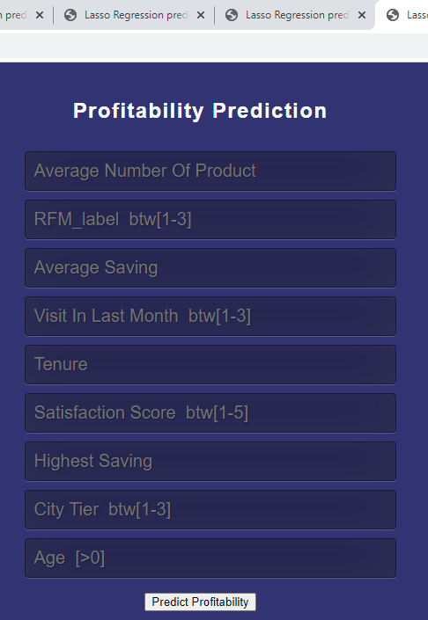
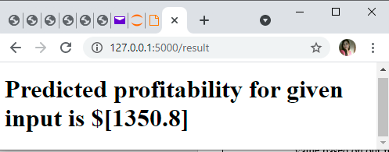
Model User Interface
Input UI
Output UI

Slide 32

Thank
You!

